Slide 1
Mesons 1

Slide 2































Slide 3
A nuclear emulsion plate is a type of particle detector first used in nuclear and particle physics experiments in the early decades of the 20th century.^{[1][2][3]} It is a modified form of photographic plate that can be used to record and investigate fast charged particles like alpha-particles, nucleons, leptons or mesons. After exposing and developing the emulsion, single particle tracks can be observed and measured using a microscope.
The nuclear emulsion plate is a modified form of photographic plate, coated with a thicker photographic emulsion of gelatine containing a higher concentration of very fine silver halide grains; the exact composition of the emulsion being optimised for particle detection.
It has the advantage of extremely high spatial precision, limited only by the size of the silver halide grains (a few microns), a precision that surpasses even the best of modern particle detectors (observe the scale in the image below, of K-meson decay). A stack of emulsion plates can record and preserve the interactions of particles so that their trajectories are recorded in 3-dimensional space as a trail of silver-halide grains, which can be viewed from any aspect on a microscopic scale.^{[3]} In addition, the emulsion plate is an integrating device that can be exposed or irradiated until the desired amount of data has been accumulated. It is compact, with no associated read-out cables or electronics, allowing the plates to be installed in very confined spaces and, compared to other detector technologies, is significantly less expensive to manufacture, operate and maintain. These features were decisive in enabling the high-altitude, mountain and balloon based studies of cosmic rays that led to the discovery of the pi-meson^{[4][5]} and parity violation in K-meson decays;^{[6]} shedding light on the true nature and extent of the subnuclear "particle zoo", defining a milestone in the development of modern experimental particle physics.^{[1]}

Slide 4
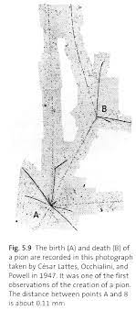

Slide 5


























Slide 6









































Slide 7

















































Slide 8















Slide 9
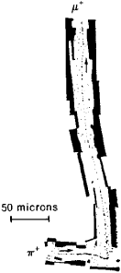















This μ travels
Powell 1947
Nobel Prize 1960
These high energy μ’s travel much

Slide 10






















that (away from heavy nuclei)
μ's decay into an electron with a range of
energies (
Most probable decay in vacuum is

Slide 11































In matter, μ-’s

Slide 12
































μ-

Slide 13






















Slide 14





Slide 15


























Slide 16




























Slide 17





























Slide 18































Slide 19































Slide 20





















